Slide 1
How to Improve Performance in 3com Business
Name
Institutional Affiliation
Date

Slide 2
Continuous Process Improvement Application in 3Com
Refers to a method for discovering opportunities for improving work and reducing wastes.
The process is believed to have been formulized by Agile in business and manufacturing.
Business can improve their performance through:
Using the model as a guideline to execute their operations. Focus more on the formal techniques to process management and project such as Lean/Agile methodologies
Notes:
Continuous process improvement application takes into consideration the presented opportunities for improving the quality of work and reducing wastes at the working place. The system helps businesses in improving their performance as well as boosting the morale of employees

Slide 3
Cont’
  Combine both Kaizen and Kanban to enable a continuous improvement through visualization of workflow
  Taking a continuous improvement as a fundamental focus to enhance customer care service values and waste reduction in form of time and cost effects
Notes:
Furthermore, the system enhances the customer care services as well as reducing time and cost effects.

Slide 4
Cont’
Enable efficient workflow that saves money and time through:
Shifting deadlines
Changing priorities
fill other complexities with opportunities for improvement
Notes:
More research affirms that the system enables the performance improvement through shifting deadlines, changing priorities and complexities with opportunities for immprovement

Slide 5
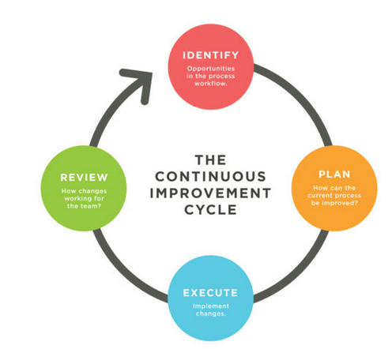
Cont’
Notes:
The model above illustrates the some of the basic elements entailed in the continuous improvement cycle.

Slide 6
Business Process Reengineering Application in 3Com
The ideology of business reengineering (BPR) refers to rethinking and breaking down existing processes.
Allows the business to improve productivity and reduce costs through efficient and newer processes
Business can be improved by BPR through:
Organizing around the outcomes and assume tasks
Locate all processes in the business and prioritize them in order of redesign urgency
Notes:
BPR takes into account the processes of rethinking and breaking down current process. Just like CPI, BPR aids the business to improve performance and cut the costs of operation

Slide 7
Cont’
Adopt information processing functions into ideal work that generates the information
Through treating geographically distributed resources as if they were centralized
Connect parallel operations in the workflow rather than integrating their outcomes
Place the decision point where the task is performed, and construct control into the process
Capture data once at the source
Notes:
BPR incorporates information processing functions for the purpose of generating information. The system mostly operates by capturing data at the source

Slide 8
Impact of data evolution on the CPI and BPR Systems in 3Com
The evolution of data may impact both CPI and BPI systems in the following way
The system may become obsolete due to dynamic nature of technology, for instance, firms may opt to adopt new technology
The role of information and technology as well as software may change due to need for new innovations at the production level of firms
Notes:
Both BPR and CPI systems are prone to effects of data evolution. For instance, the technological advancement renders them obsolete withtime

Slide 9
Cont’
Firms may face competition due to rapid development and roll out of new products. For instance, firms that may fail to adjust to new systems may be faced out of their respective industries
Data evolution may also improve the efficiency of these systems due to new innovations
Notes:
Furthermore, firms face competition due to rapid development and roll out of new products. However, data evolution may also improve CPI and BPR systems in the long run.

Slide 10
Measuring the initiative of Continuous Processing improvement in 3Com
The improvement initiative of CPI to a company can be measured in the following ways:
Through the ability of the business to meet its objectives of:
Increasing profits
Reducing costs
Notes:
The initiatives of CPI can be measured through the realization of the company’s goals which manifests through profit increment and cost reduction.

Slide 11
Cont’
Accelerating innovation
Enhance quality of product service
Enhanced or improved safety in the production
Effective business customer satisfaction
Improved working morale among the employees
Notes:
Comparatively, measuring the system initiatives entails observing accelerated innovations as well as the enhanced quality of product service

Slide 12
Measuring the Initiative of Business Processing Reengineering in 3Com
The initiative of BPR with regard to business performance in 3Com can be measured through:
Improved productivity
Comprehensive exploitation of business resources
Improved profit margin
Customer service satisfactory
Reduction or elimination of wastes

Slide 13
References
Cole, R. E. (2000, September 18). From Continuous Improvement to Continuous Innovation. Retrieved March 7, 2018, from ASQ: http://asq.org/pub/qmj/past/vol8_issue4/cole.html
Shields, P. (2017, March 18). What is Continuous Process Improvement? Retrieved March 7, 2018, from Business Port : http://www.businessport.net/continuous-process-improvement-explained/

